Slide 1

Tools to Engage Adults to Receive Care
Based on their Values and Choices
For Care Providers and Staff
Ellen DiPaola, Esq., President & CEO

Slide 2
Person-Centered Care Goals
Engage residents & families in planning discussions
Understanding what quality of life means to each individual
Understand changing health needs & care choices
Offer care that matches an adult’s values, goals and choices
Help empower resident’s voice to direct care and comfort

Slide 3
Challenges
Lack of consistent assignment
Having dedicated time to discuss quality of life
Lack of family involvement or support
Understand decision-making authority of family, Health Care Agent, Guardian

Slide 4

Everyone is on a health care journey
to get the best possible care
Notes:
We believe that Everyone is on a health care journey to get the best possible care at every phase of health, whether we are promoting our everyday wellness, managing health needs & chronic illness as we age, or living with a serious advancing illness.

Slide 5
Everyone needs a plan
A health care plan is your personal road map for quality care
Notes:
Everyone’s journey needs a plan.
Starting at 18 yrs old, you have the power to make your own health care decisions, and write down your decisions in a care plan.
Your health care plan is your personal road map to get the best possible care at every phase of health.

Slide 6



Making a plan helps everyone
Honoring Choices has free planning tools to make a plan
Protects Resident
Supports the Family
Helps Care Providers

Slide 7

How do planning tools help?
Start 1-1 discussions
Use in Planning Meetings
Help adults use their voices to improve quality of life
Help families understand policy & procedures
Clarify role & authority of Health Care Agent & Guardian

Slide 8

Who’s Your Agent?® Program
The Getting Started and Next Steps Tool Kits
open the door to lifelong health care planning

Slide 9

The Getting Started Tool Kit
It’s as easy as 1-2-3!
© 2017 Honoring Choices Massachusetts, Inc.

Slide 10
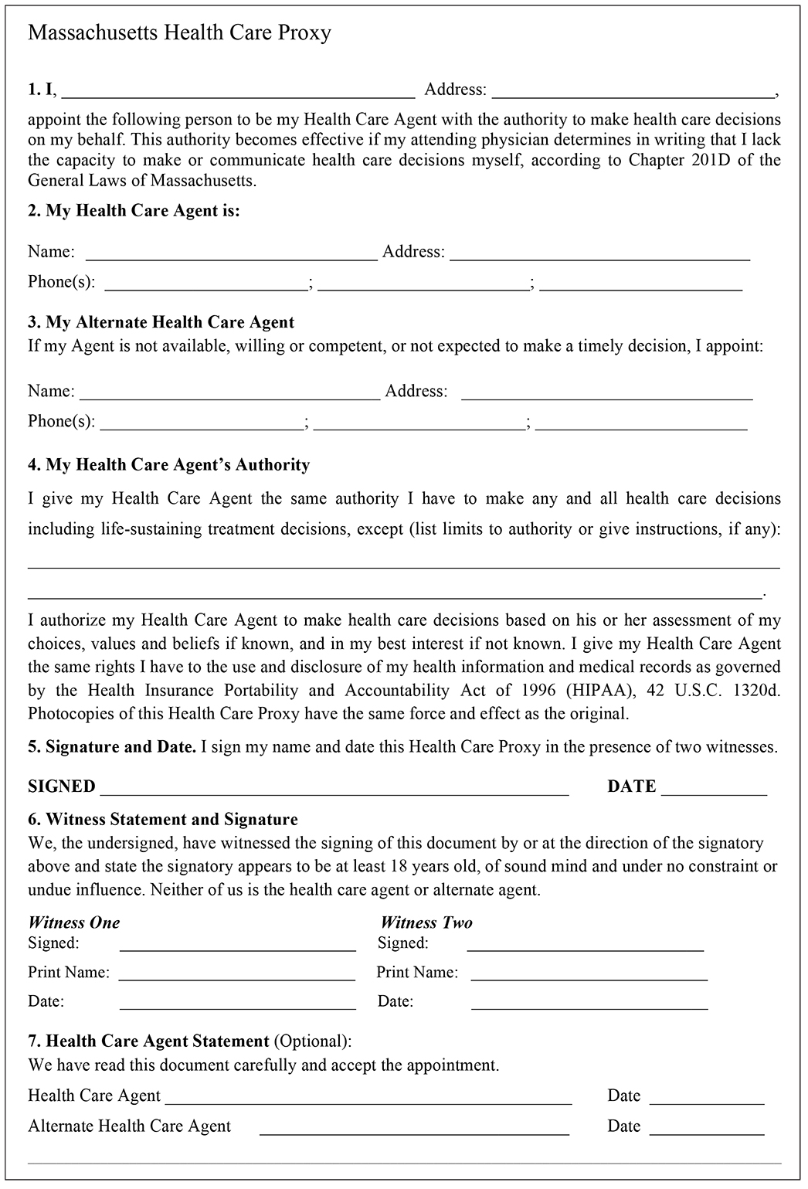
Step 1- Choose a Health Care Agent in a Health Care Proxy
Instructions Page
Print Your Name
Agent’s Name
Alternate Agent’s Name
Give your Agent “Any & All” decision-making power OR write in limits or instructions
You sign & date in front of two witnesses
Witnesses One and Witness Two sign & date
Optional: Agent signs

Slide 11
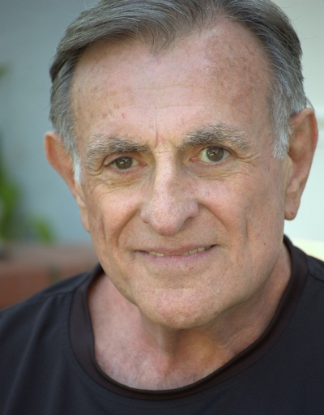


What if you have not chosen a Health Care Agent?
“No Agent. No Problem!”
Just start with the Personal Directive.

Slide 12

A Personal Directive is like a personal letter from you to your Agent, family & doctors.
Step 2: Talk with family. Write down your care choices
in a Personal Directive(Living Will)
Write down what’s important to you: values, beliefs, choices
Give instructions for the care you want & do not want
It’s not a legal document, but gives your doctor vital information to match care to your choices
Also called a Living Will

Slide 13
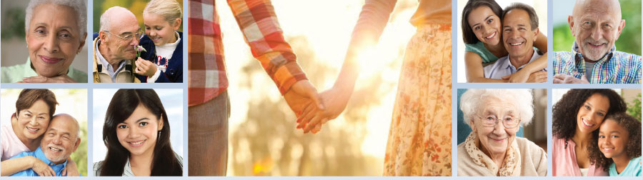
If you have chosen an Agent-
Here’s How It Works:
“Your Health Care Proxy & Personal Directive
work hand-in-hand.”
Health Care Proxy
• Choose an Agent
• Give decision-making power
Personal Directive (Living Will)
• Tell Agent what’s important
• Give instructions for care
© 2018 Honoring Choices Massachusetts, Inc.

Slide 14
If you have NOT chosen an Agent-
Here’s How It Works:
“No Agent. No Problem!”
Start with the Personal Directive
Think about your values & beliefs
Make your care choices
Write down your choices in a Personal Directive (Living Will)
© 2018 Honoring Choices Massachusetts, Inc.

Slide 15
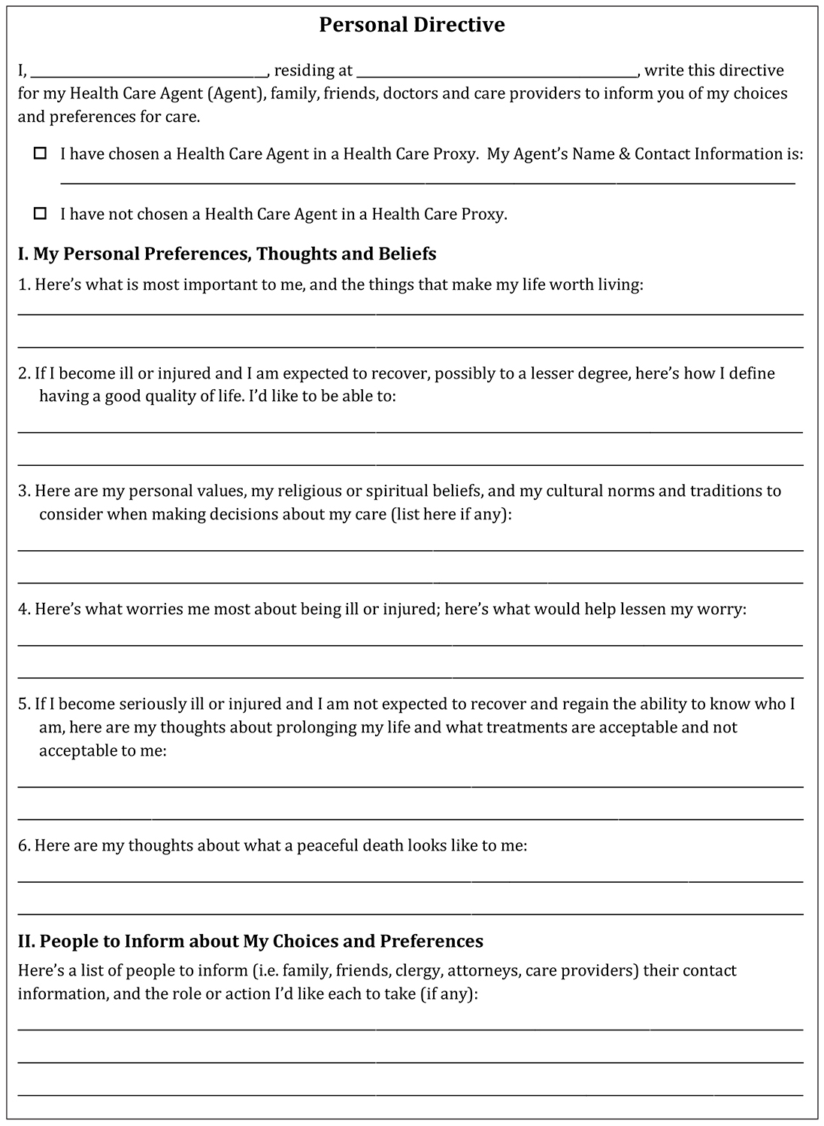
Honoring Choices Personal Directive (Short form- 2 pages)
Instructions Page 1
Your Name & Address
Check a the box
I. My Personal Preferences, Thoughts and Beliefs
II. People to Inform about My Choices and Preferences

Slide 16
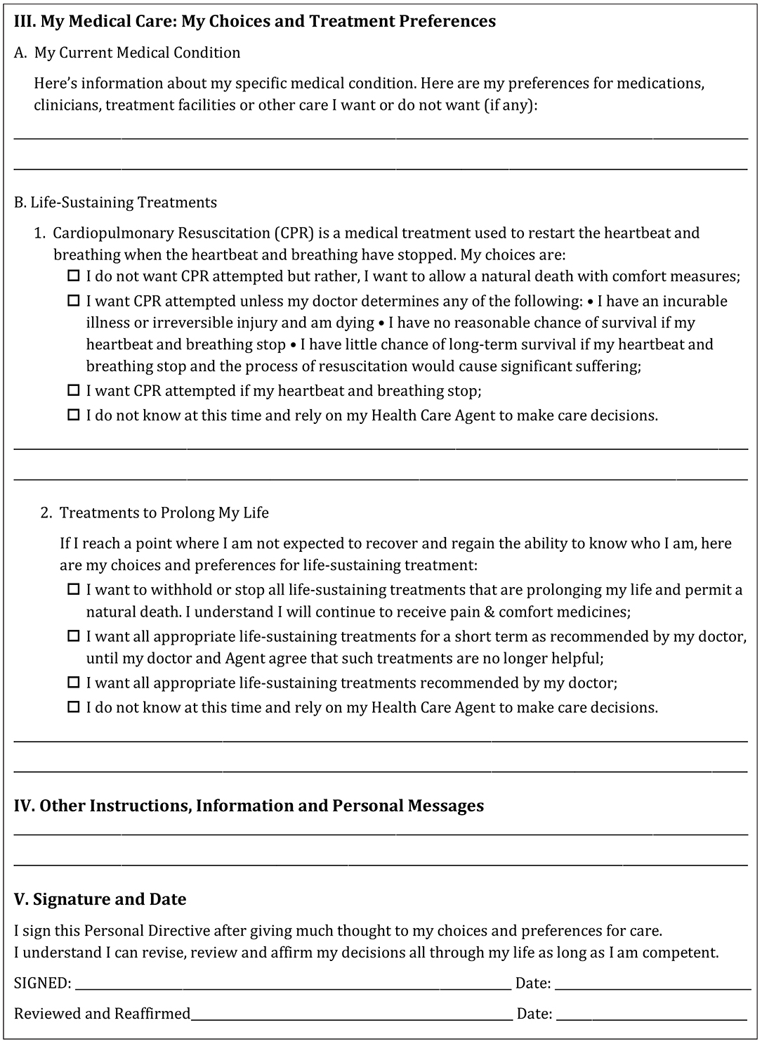
Instructions Page 2
III. My Medical Care: My Choices and Treatment Preferences
A. My Current Medical Condition
B. Life-Sustaining Treatments
1. CPR
2. Treatments to Prolong My Life
IV. Other Information, Instructions and Messages:
V. SIGNATURE and Date

Slide 17
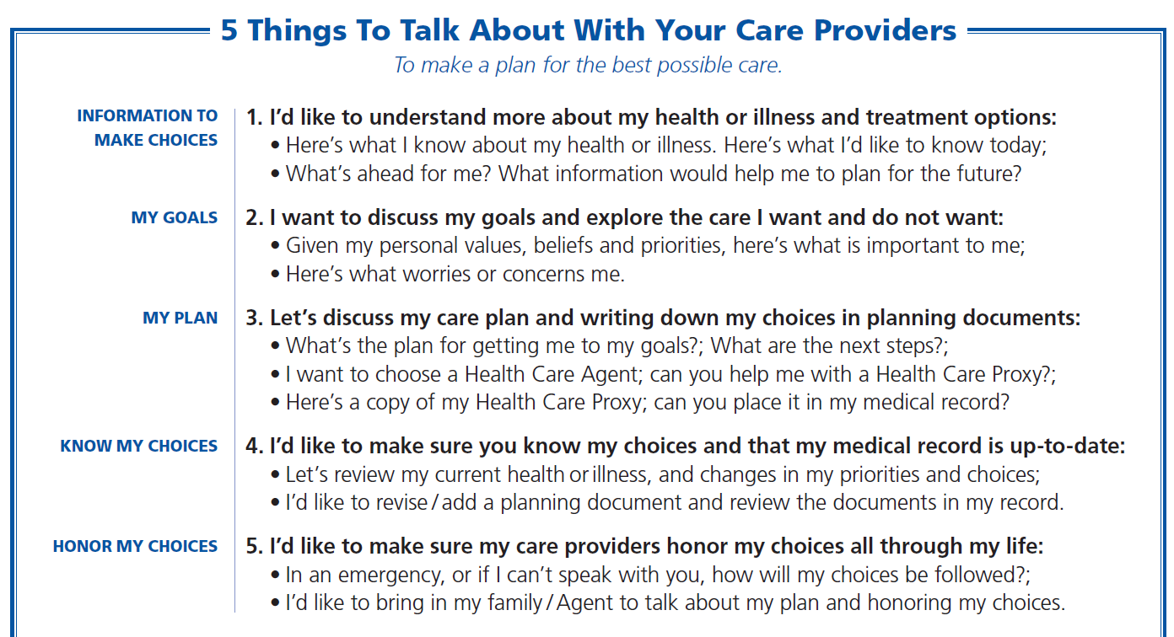
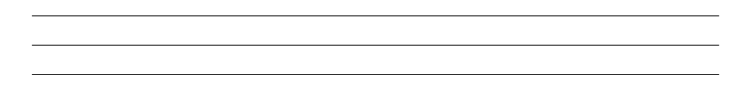
Step 3: Talk with care providers to match care to your choices.
© 2018 Honoring Choices Massachusetts, Inc.

Slide 18
Next Steps Tool Kit
Build on your planning discussions.
Add & revise your planning documents.

Slide 19

Next Steps Tool Kit
• Keep talking! Handy Discussions Guides
▪ Managing Chronic Illness
▪ Living with Serious Illness
• What’s in Your Health Care Plan?
5 MA Planning Documents:
✓ Health Care Proxy
✓ Personal Directive
□ Durable Power of Attorney
□ MOLST: Medical Orders for Life Sustaining Treatment
□ CC/DNR: Comfort Care, Do Not Resuscitate Order
• Explore Palliative Care: Fact Sheet & Discussion Guide
• Explore Hospice Care

Slide 20

“Who do you want to make financial decisions for you if you can’t make financial decisions yourself?”
Massachusetts Durable Power of Attorney
Durable Power of Attorney:
It’s a legal document you can do with an attorney (recommended)
You choose a person you trust, called an Attorney-in-fact, who can step-in to manage your money, property & financial matters
An Attorney-in-fact helps to arrange & pay for long term care

Slide 21

“If you have a serious advancing illness, what life-sustaining treatments would be acceptable to you?”
Medical Orders for Life-Sustaining Treatment or
MOLST form
Medical Orders for Life-Sustaining Treatment, MOLST
Discuss your current medical condition with your clinician.
Your clinician explains the benefits, risks, and possible outcomes of attempting life-sustaining treatments
You make treatment choices about the care you want and do not want
You and your clinician record choices and sign the MOLST form
Every person involved in your health care follows your choices.

Slide 22
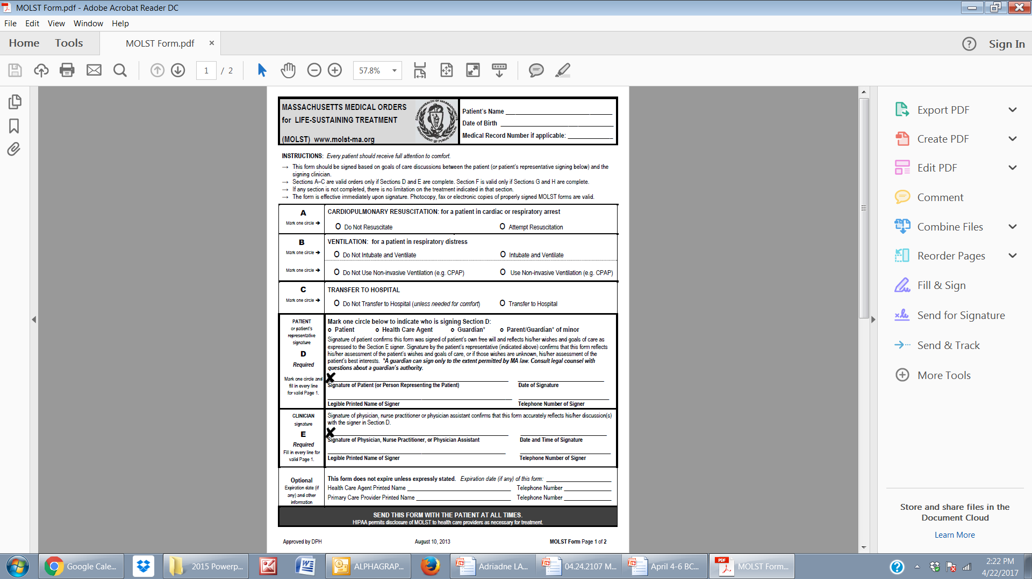
For adults with serious illness or frailty
Talk about life-sustaining treatments; if resident elects, sign a MOLST form
MOLST IS VOLUNTARY

Slide 23
What is Palliative Care?
Palliative care is specialized health care for individuals
diagnosed with a serious illness or trauma.
Palliative care clinicians work with primary care to help patients:
• Reduce the pain and symptoms of serious illness or trauma
• Reduce psychological, emotional and spiritual stress
• Support patients and their families

Slide 24
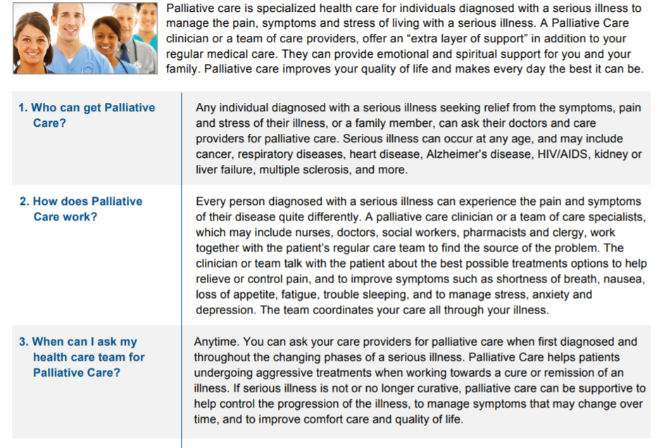
Palliative Care Fact Sheet
Common questions & answers

Slide 25
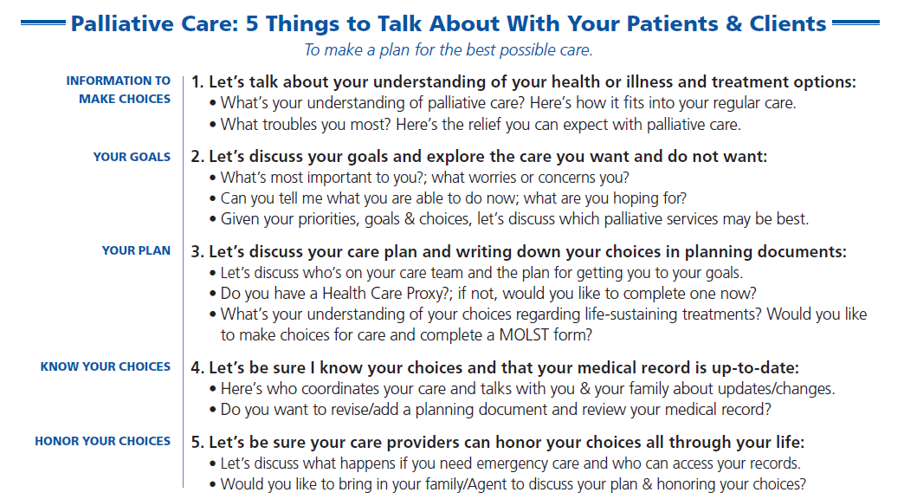
Clinician’s Palliative Care Discussion Guide

Slide 26
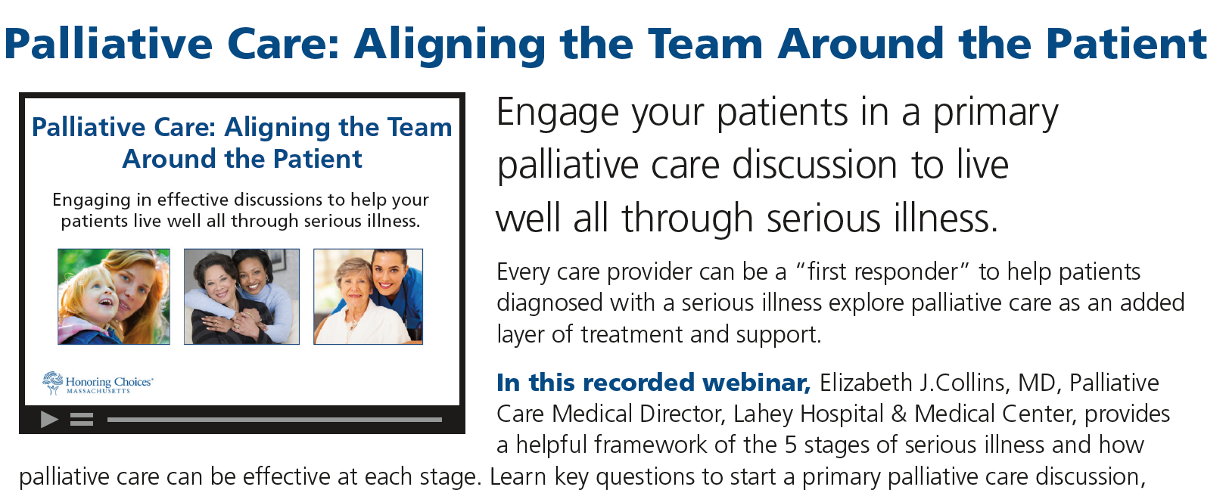
Palliative Care Webinar
Start a Palliative Care Discussion

Slide 27
Tools to Engage Adults in
Person-Centered Care
Free, downloadable tools, discussion guides, webinars
www.honoringchoicesmass.com
For questions, contact Ellen DiPaola, President
edipaola@honoringchoicesmass.com
Thank you for watching!

